Slide 1
CSE 440
Artificial Intelligence
Local Search
Dr. Mohammad Mahmudul Alam
Department of Electrical & Computer Engineering (ECE)
North South University (NSU)

Slide 2
Last Time
Informed Search - one that uses problem specific knowledge … can find solutions more efficiently than an uninformed strategy.
Greedy Best First Search
“Always chooses the successor node with the best f value” where f(n) = h(n)
We choose the one that is nearest to the final state among all possible choices
A* Search
Best first search using an “admissible” heuristic function f that considers the current cost g(n), f(n) = g(n) + h(n)
Always returns the optimal solution path

Slide 3
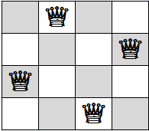
Local Search
In the previous search problems, we wanted to find paths through the search space.
But sometimes we care only about the final state, not the path to get there.
For example, in the 4-queens problem, we care only about finding a valid final configuration of the 4-queens.
Because if you know the configuration, it is trivial to reconstruct the steps that created it.

Slide 4
Local Search
This is also true for many important applications such as
Integrated-Circuit Design
Factory Floor Layout
Job-shop Scheduling
Automatic Programming
Telecommunications Network Optimization
Crop Planning
Portfolio Management

Slide 5
Local Search: Key Idea
Key idea (surprisingly simple):
Select (random) initial state (generate an initial guess)
Make local modification to improve current state (evaluate current state and move to other states)
Repeat Step 2 until goal state found (or out of time)

Slide 6
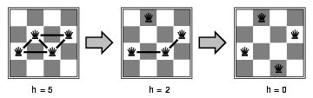
Example: 4-Queen
States: 4 queens in 4 columns (256 states)
Operators: move queen in column
Goal test: no attacks
Evaluation: h(n) = number of attacks
Initial Random Guess
Goal State

Slide 7
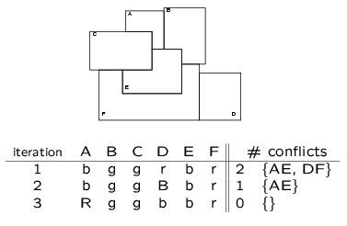
Example: Graph Coloring
Example: Graph Coloring
Start with random coloring of nodes
Change color of one node to reduce # of conflicts
Repeat 2

Slide 8
Local Search: Advantages
Local search algorithms operate on a single state – current state – and move to one of its neighboring states.
The principle: keep a single "current" state, try to improve it
Therefore: Solution path needs not be maintained.
Hence, the search is “local”.
Two advantages:
Use little memory.
More applicable in searching large/infinite search space. They find reasonable solutions in this case.

Slide 9
Local Search: Algorithms
Hill-climbing Search
Simulated Annealing
Local beam search
Gradient Descent/Ascent

Slide 10

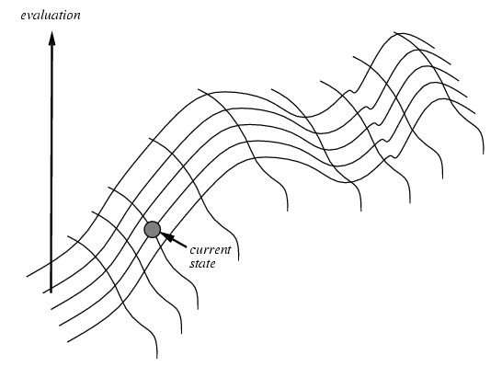


Hill-climbing Search
"Like climbing Everest in thick fog with amnesia"
Hill-climbing search algorithm (also known as greedy local search) uses a loop that continually moves in the direction of increasing values (that is uphill).
It terminates when it reaches a peak where no neighbor has a higher value.
Notes:
Amnesia (from Greek Ἀμνησία) is a deficit in memory caused by brain damage, disease etc.

Slide 11






Hill-climbing Search
Looks one step ahead to determine if any successor is “better” than current state, then moves to best choice.
If there exists a successor s for the current state n such that
  h(s) > h(n) – it’s better than where we are now
  h(s) >= h(t) for all the successors t of n – and better than other choices then
  Move from n to s, Otherwise, halt at n.
Greedy search that uses objective function h()
  But does not allow backtracking or jumping to an alternative path
  Doesn’t “remember” where it has been
Not complete or optimal
  Search will terminate at local minima, plateaus, ridges.

Slide 12
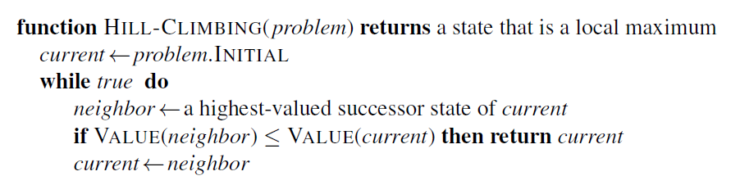
Hill-climbing Search
Algorithm

Slide 13
Hill-climbing Search
Evaluation
States

Slide 14
Hill-climbing Search
Cost
States

Slide 15
Hill-climbing Search
Current Solution

Slide 16
Hill-climbing Search
Current Solution

Slide 17
Hill-climbing Search
Current Solution

Slide 18
Hill-climbing Search
Current Solution

Slide 19








Hill-climbing Search
Best
Local Minimum
Global Minimum

Slide 20
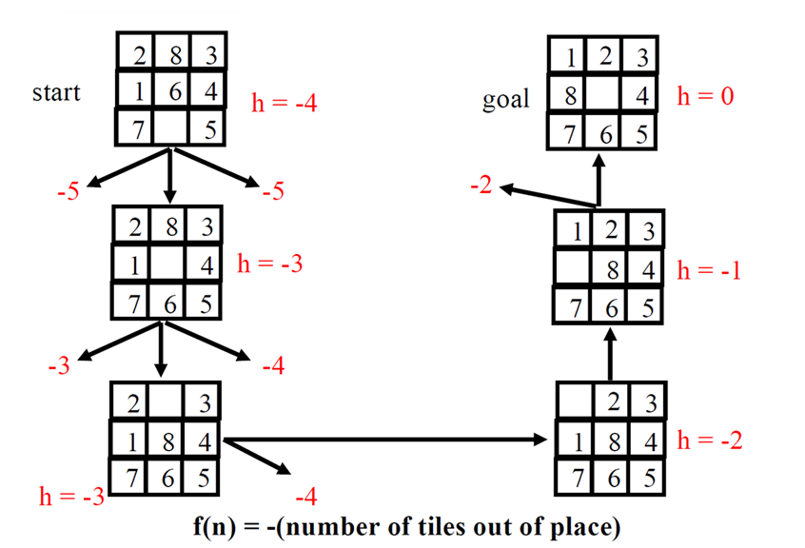










Hill-climbing: 8-puzzle
Here, it makes the best choice and the next work based
On current state

Slide 21
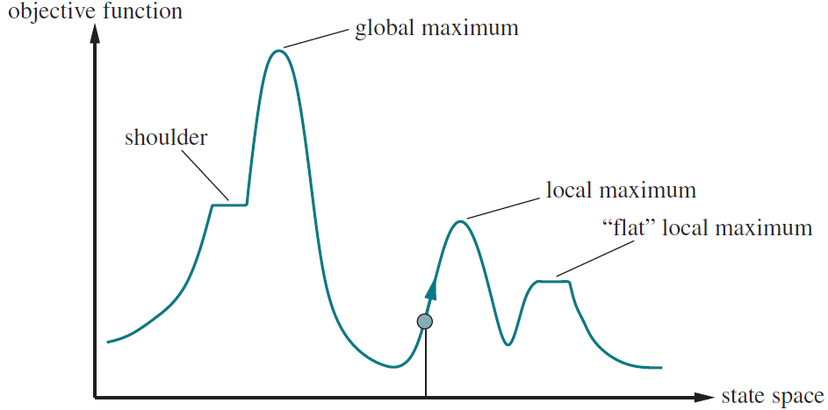
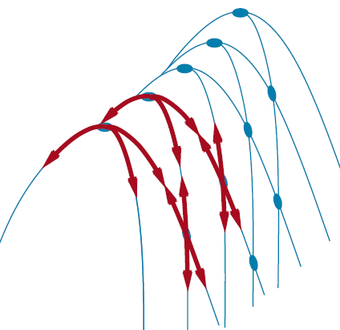



Hill-climbing: Drawbacks
Local maxima/minima: Local search can get stuck on a local maximum/minimum and not find the optimal solution.
Ridges: Ridges result in a sequence of local maxima that is very difficult for greedy algorithms to navigate.
Plateaus: A plateau is a flat area of the state-space landscape. Hill-climbing search can get lost wandering on the plateau.
Ridges
Local Maxima
Plateau /pla-tow/

Slide 22
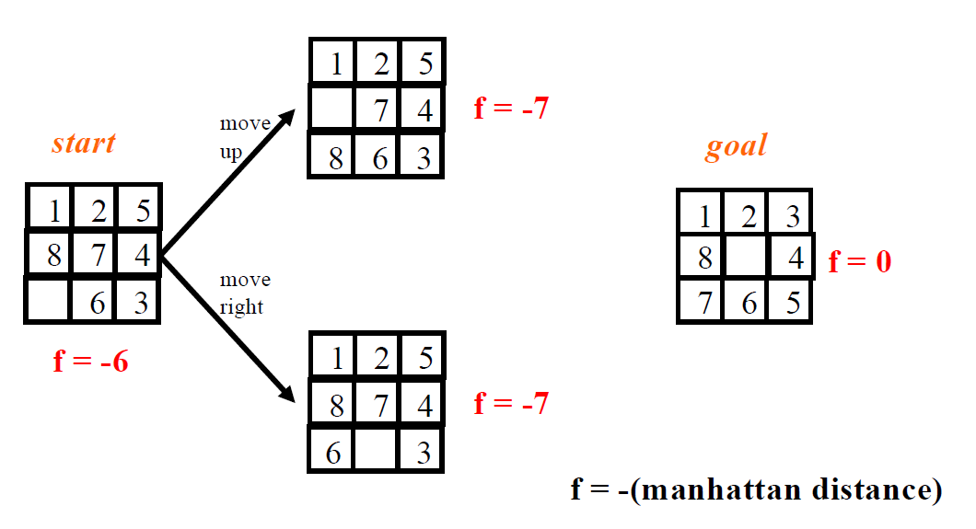
Hill-climbing: Example of Local Minima

Slide 23

Hill-climbing: Remedies
Problems: local optima, plateaus, ridges
Remedies:
  Random restart: keep restarting the search from random locations until a goal is found.
  Problem reformulation: reformulate the search space to eliminate these problematic features.
Some problem spaces are great for hill climbing; others are terrible.

Slide 24
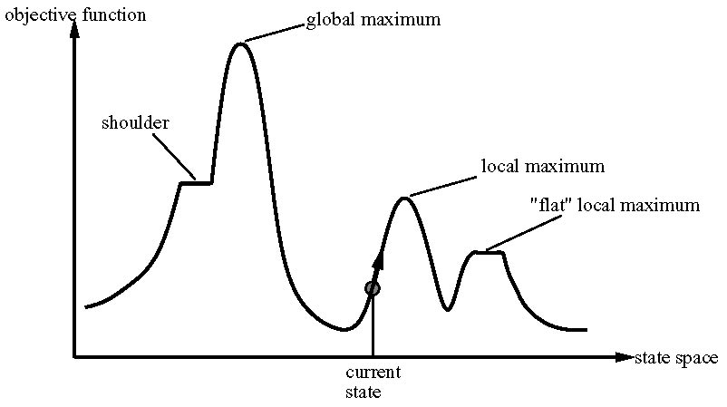
Hill-climbing: Random Restart
Randomly generate an initial state until a goal is found.
It is trivially complete with probability approaching to 1.
Example:
  For 8-queens problem, very effective.
  For three million queens, solve the problem within minute.
Notes:
Flat local maximum: No uphill exists
Shoulder: progress is possible

Slide 25
Hill-climbing: Limit Sideways Move
Hoping that plateau is really a shoulder.
Limit the number of sideway moves, otherwise infinite loop.
Example:
  100 consecutive sideways moves for 8-queen problem
  Chances of solving problem increase from 14% to 94%
  It is incomplete, because stuck at local maxima
Notes:
Flat local maximum: No uphill exists
Shoulder: progress is possible

Slide 26
Extensions of Hill Climbing
Simulated Annealing:
  Escape local maxima by allowing some “bad” moves but gradually decreasing their frequency
Local Beam Search
  Keep track of k states rather than just one
  At each iteration:
    All successors of the k states are generated and evaluated
    Best k are chosen for the next iteration
Notes:
Flat local maximum: No uphill exists
Shoulder: progress is possible

Slide 27
Simulated Annealing
Key Idea: Escape local maxima by allowing some "bad" moves but gradually decrease their frequency
Take some uphill steps to escape the local minimum
Instead of picking the best move, it picks a random move
If the move improves the situation, it is executed Otherwise, move with some probability less than 1
Physical analogy with the annealing process:
  Allowing liquid to gradually cool until it freezes
The heuristic value is the energy, E
Temperature parameter T, controls speed of convergence

Slide 28


Simulated Annealing
Basic inspiration: What is annealing?
In metallurgy, annealing is the physical process used to temper or harden metals or glass by heating them to a high temperature and then gradually cooling them, thus allowing the material to coalesce into a low energy crystalline state.
Simulated Annealing combines Hill Climbing with a random walk in some way that yields both efficiency and completeness.
Used to solve VLSI layout problems in the early 1980.

Slide 29
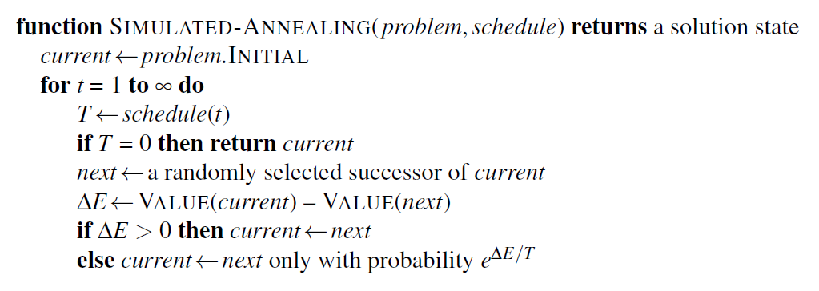
Simulated Annealing
Algorithm

Slide 30
Simulated Annealing
Cost
Best
States

Slide 31
Simulated Annealing
Cost
Best
States

Slide 32
Simulated Annealing
Cost
Best
States

Slide 33
Simulated Annealing
Cost
Best
States

Slide 34
Simulated Annealing
Cost
Best
States

Slide 35
Simulated Annealing
Cost
Best
States

Slide 36
Simulated Annealing
Cost
Best
States

Slide 37
Simulated Annealing
Cost
Best
States

Slide 38
Simulated Annealing
Cost
Best
States

Slide 39
Simulated Annealing
Cost
Best
States

Slide 40
Simulated Annealing
Cost
Best
States

Slide 41
Simulated Annealing
Cost
Best
States

Slide 42
Simulated Annealing
Cost
Best
States

Slide 43
Simulated Annealing
Cost
Best
States

Slide 44
Simulated Annealing
Cost
Best
States

Slide 45
Simulated Annealing
Cost
Best
States

Slide 46
Simulated Annealing
Cost
Best
States

Slide 47
Simulated Annealing
Cost
Best
States

Slide 48
Simulated Annealing
Cost
Best
States

Slide 49
Simulated Annealing
Cost
Best
States

Slide 50
Simulated Annealing
Cost
Best
States

Slide 51
Simulated Annealing
Cost
Best
States

Slide 52
Simulated Annealing
Cost
Best
States

Slide 53



Simulated Annealing
Temperature T
Used to determine the probability
  High T : large changes
  Low T : small changes
Cooling Schedule
Determines rate at which the temperature T is lowered.
Lowers T slowly enough, the algorithm will find a global optimum.
In the beginning, aggressive for searching alternatives, become conservative when time goes by.

Slide 54
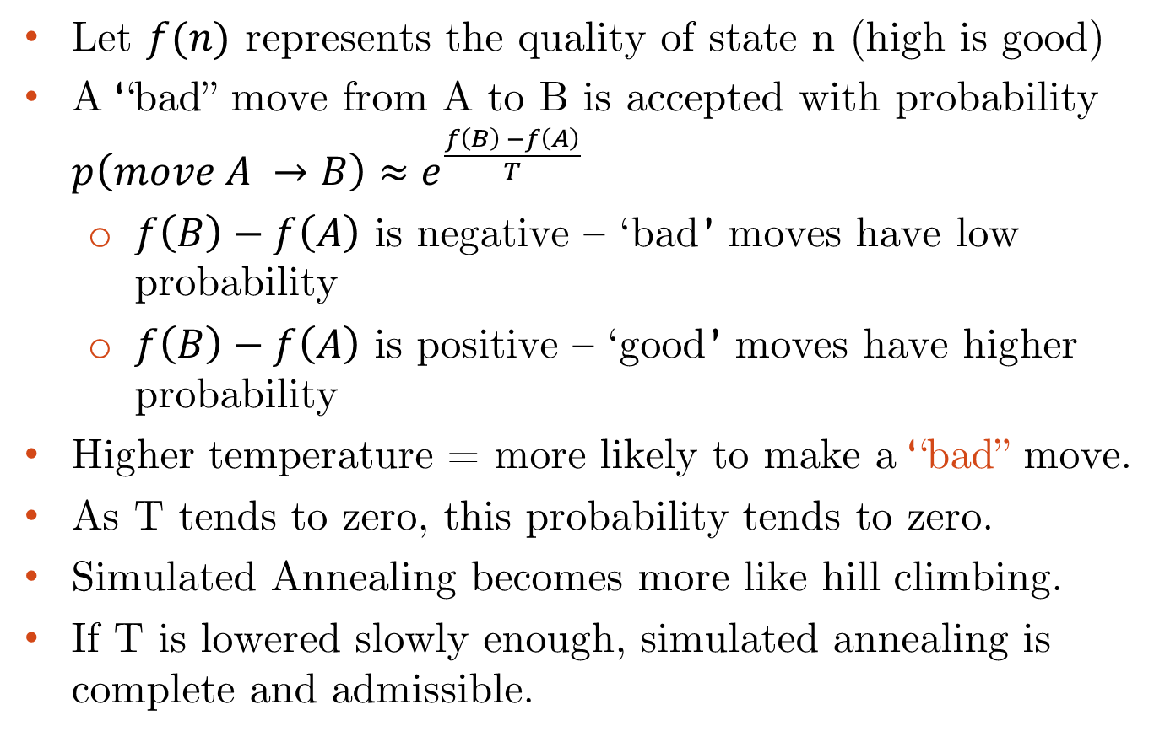

Simulated Annealing
Let $f(n)$ represents the quality of state n (high is good)
A “bad” move from A to B is accepted with probability $p\left(move A →B\right)≈e^{\frac{f\left(B\right) −f\left(A\right)}{T}}$
  $f\left(B\right)−f\left(A\right)$ is negative – ‘bad’ moves have low probability
  $f\left(B\right)−f\left(A\right)$ is positive – ‘good’ moves have higher probability
Higher temperature = more likely to make a “bad” move.
As T tends to zero, this probability tends to zero.
Simulated Annealing becomes more like hill climbing.
If T is lowered slowly enough, simulated annealing is complete and admissible.

Slide 55

Local Beam Search
Key Idea: Unlike Hill Climbing, Local Beam Search keeps track of k states rather than just one.
It starts with k randomly generated states. At each step, all the successors of all the states are generated.
Keep the k best states across all successors.
If any one is a goal, the algorithm halts, otherwise it selects the k best successors from the complete list and repeats.

Slide 56
Local Beam Search
In random-restart, each search process runs independently and sequential.
Local beam search, on the other hand, runs k random restarts in parallel.
Drawback: less diversity → Stochastic Beam Search (SBS)
Instead of choosing the top k successors, choose successors with probability proportional to successor’s value.
Thus, SBS increases diversity.

Slide 57
Local Beam Search
Cost
States

Slide 58
Local Beam Search

Slide 59
Local Beam Search

Slide 60
Local Beam Search

Slide 61
Local Beam Search

Slide 62
Local Beam Search

Slide 63
Local Beam Search

Slide 64
Local Beam Search

Slide 65
Local Beam Search

Slide 66
Local Beam Search

Slide 67
Local Beam Search

Slide 68
Local Beam Search

Slide 69
Local Beam Search

Slide 70
Local Beam Search

Slide 71
Local Beam Search

Slide 72
Local Beam Search

Slide 73


Gradient Descent/Ascent
In Hill-climbing search, the objective function is discrete and non-differentiable. Moves in the direction of the best neighbor.
Gradient Descent/Ascent is similar mathematical optimization algorithm where the objective function is continuous and differentiable.
Instead of moving along the best neighbor, it moves along the gradient.
Gradient Descent/Ascent can use momentum, stochastic variants, or second-order methods to escape local optima.

Slide 74
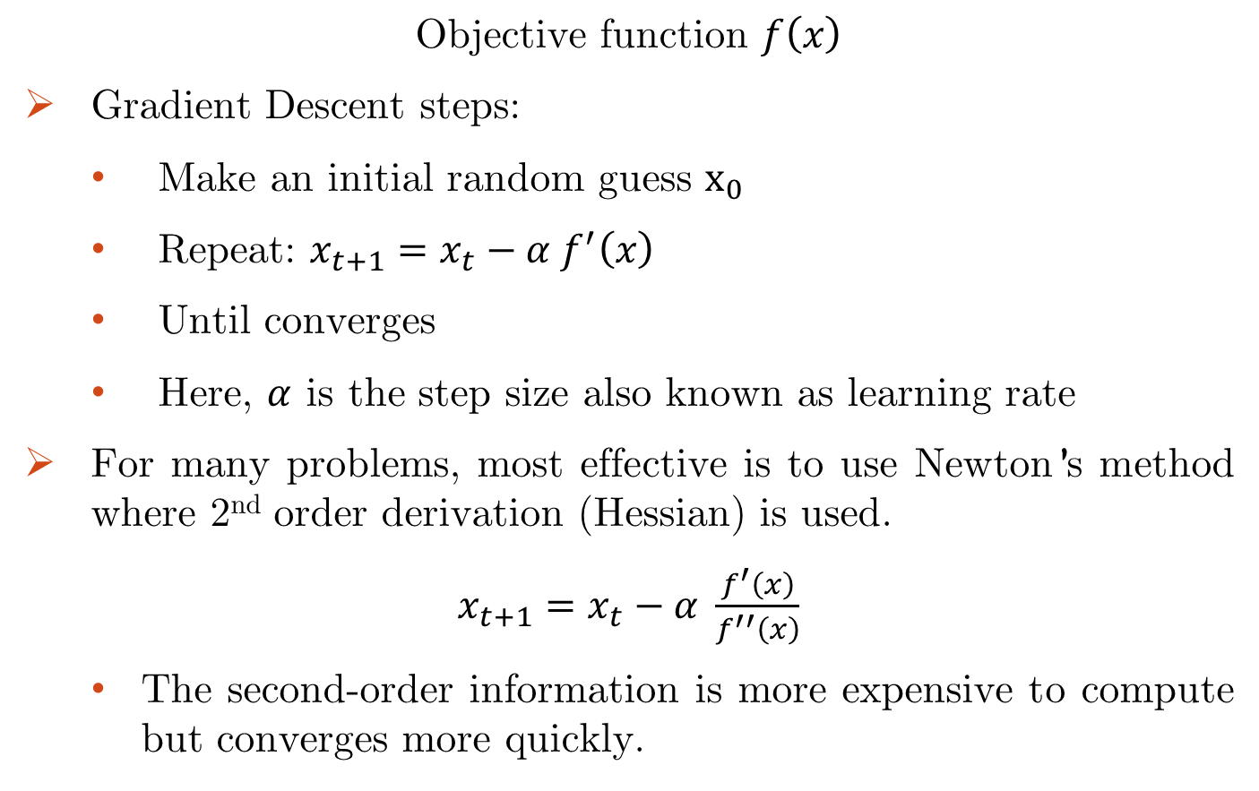
Gradient Descent/Ascent
Objective function $f\left(x\right)$
Gradient Descent steps:
  Make an initial random guess $x_{0}$
  Repeat: $x_{t+1}=x_{t}−α f^{′}\left(x\right)$
  Until converges
  Here, $α$ is the step size also known as learning rate
For many problems, most effective is to use Newton’s method where 2nd order derivation (Hessian) is used.
$x_{t+1}=x_{t}−α \frac{f^{′}\left(x\right)}{f^{′′}\left(x\right)}$
  The second-order information is more expensive to compute but converges more quickly.

Slide 75
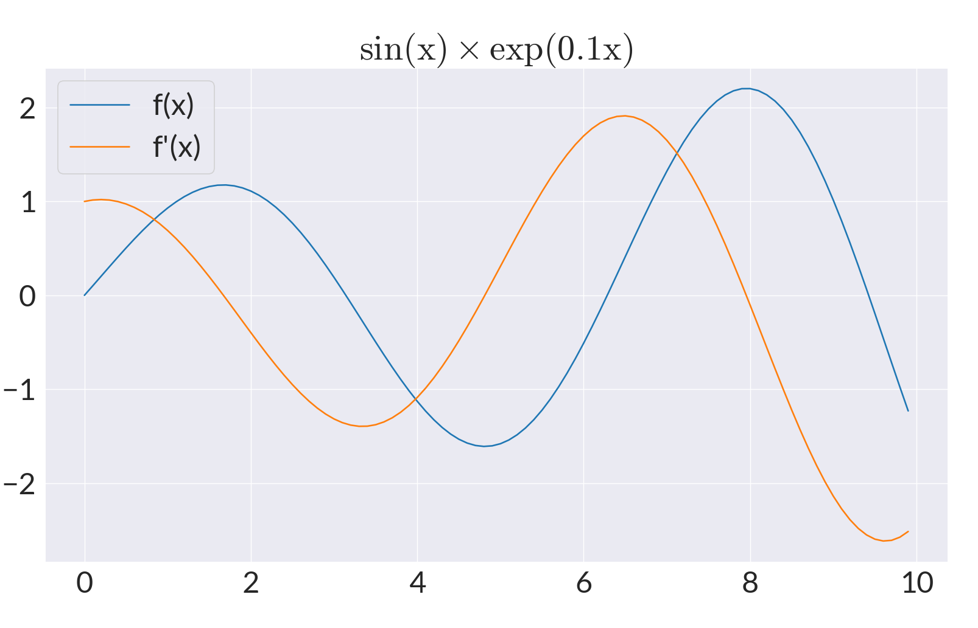
Gradient Descent/Ascent

Slide 76
Summary
Best-first search is a class of search algorithms where minimum-cost nodes are expanded first.
Greedy search uses minimal estimated cost h(n) to the goal state as measure of goodness, reduces search time, but is neither complete nor optimal.
Hill-climbing algorithms keep only a single state in memory but can get stuck on local optima.
Simulated annealing escapes local optima and is complete and optimal given a “long enough” cooling schedule.
Gradient Descent/Ascent is suitable when the objective function is continuous and differentiable.

Slide 77
Reading
Chapter 04 of the textbook
Pages 129 to 133, 137 to 140

